Slide 1
To be a great learner… Get the MAGIC habits
Your Challenge Zone
© Jackie Beere Associates

Slide 2
Get the MAGIC habits of success…
M - Motivation – can you get yourself motivated for learning?
A – Attitude is everything. Positive people are more popular and happy
G – Gumption or grit is about being brave and up for getting on with the challenge of learning
I – I-learn helps you understand your brain and how to make the most of it
C – Communication skills are very important to work in teams and get on with friends.
© Jackie Beere Associates

Slide 3
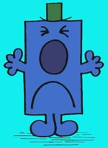
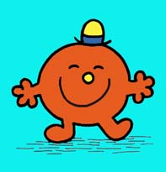
M is for motivation
I am motivated to work hard and do well
I can’t be bothered
© Jackie Beere Associates

Slide 4
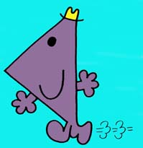
A is for attitude
I am always positive and love a challenge – I know that the harder I work, the cleverer I get!
I feel angry if I get it wrong and give up easily
© Jackie Beere Associates

Slide 5
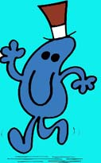
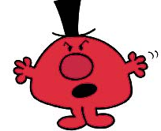
G is for gumption or grit
If things get hard I just keep trying until I get it right
When I get stuck I get upset and give up
© Jackie Beere Associates

Slide 6
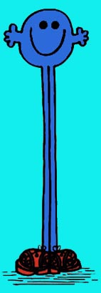
I is for I-learn
I know how my brain works and what to do when I get stuck
I am not a good learner… yet!
© Jackie Beere Associates

Slide 7
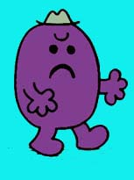
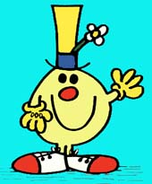
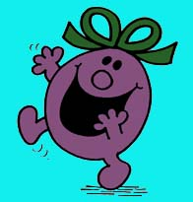
C is for communication
I prefer working on my own and don’t always get on with others
I love working in teams and helping us all to do well
© Jackie Beere Associates

Slide 8
It takes courage to make the most of the MAGIC!
Do you stay in your comfort zone and never take chances?
Have you got the courage to take a chance and make the changes you need to??
© Jackie Beere Associates

Slide 9
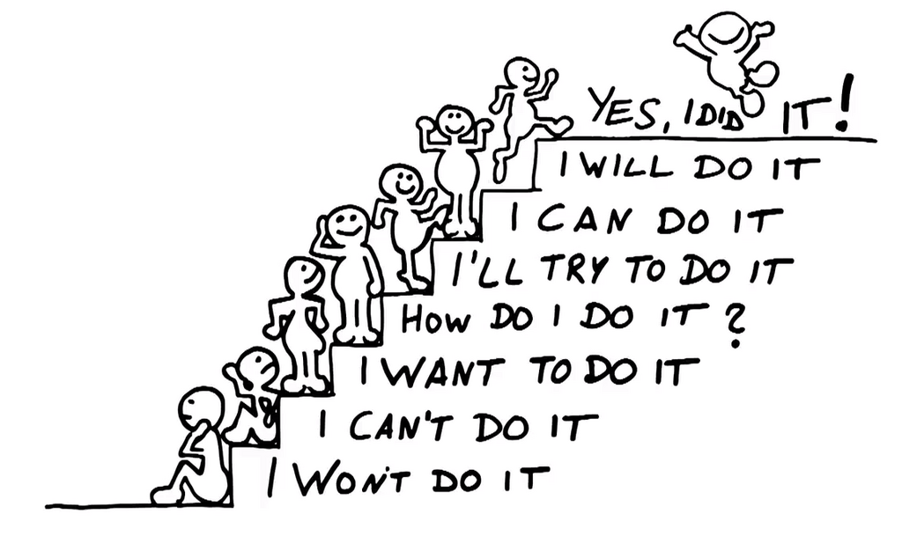
Take the steps to learning
And to a Growth
mindset
© Jackie Beere Associates

Slide 10
Market Place task – teams of 3
Each group of three has a card with more information about ONE of the habits
You have 4 minutes to read it
You have 4 minutes to create a visual aid to teach others about it. ONLY 6 WORDS allowed, but you can use as many pictures/images/symbols/acronyms etc. as you like
One person stays as the teacher, the other two go to other groups and find out as much as they can about the other four habits in 6 minutes
Return to your groups and teach your teacher what you have learned
Take the group test – prize for the highest score!
© Jackie Beere Associates

Slide 11
MAGIC team test
Write down the names of the 5 MAGIC habits with a catchy mantra for each one
Which one do you need to work on the most?
How did you learn in that activity?
© Jackie Beere Associates

Slide 12
G
A
I
Your MAGIC habit targets.
Which habits do you need to work on the most?
Write down 3 things that you will do in the palm of the hand.
Now cut out the hand and add it to the wall display.
C
M
© Jackie Beere Associates

Slide 13
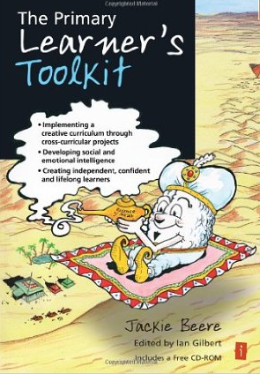
Buy the Primary Learner’s Toolkit
Get 22 lessons on how to teach the MAGIC habits
Plus lots of cross-curricular projects which help develop them
Available from Crown House Publishing and Amazon
Also check out The Learner’s Toolkit for Key Stage 3

