Slide 1
The mindsets of Mr Men

Slide 2
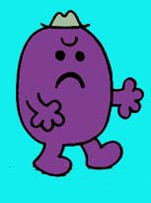
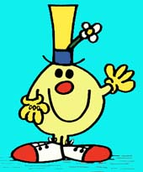
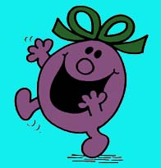
F
G
I find that people can change if I can motivate them
People never change

Slide 3
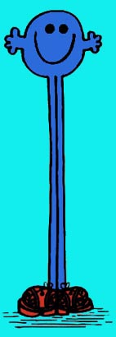
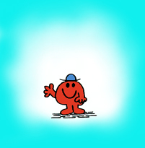
F
G
If people don’t like me – tough. I’d rather not know.
If people don’t like me, I want to do something about it

Slide 4
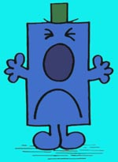
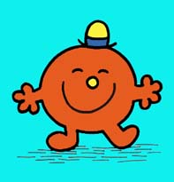
F
G
Intelligence is something you are born with - and that’s how it stays
I have definitely become more clever as I have got older

Slide 5
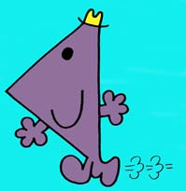
F
G
When you learn stuff, the harder you have to work the cleverer you will get
You can learn things but that doesn’t make you more intelligent

Slide 6
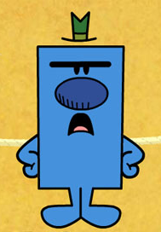
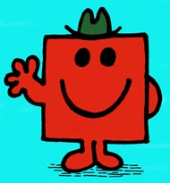
F
G
I hate getting things wrong
If I get it wrong, I need to learn why

Slide 7
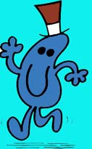
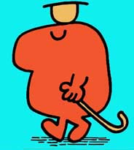
F
G
I can always think of ways I could improve
There are some things I will never be able to improve on

Slide 8
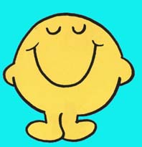
F
G
I have my standards and I will never change them
Sometimes I reflect on whether I am always right

Slide 9
F
G
I stay well in my comfort zone and never take any chances
I’ve got the courage to take a chance and make the changes I need to make

Slide 10
F
G
I can find reasons or excuses to keep doing things the same way
I believe that I am a change agent… especially for my pupils

Slide 11
F
G
I love a challenge!! ☺ ☺
The thought of another new initiative just makes me weep… ☹

